Slide 1

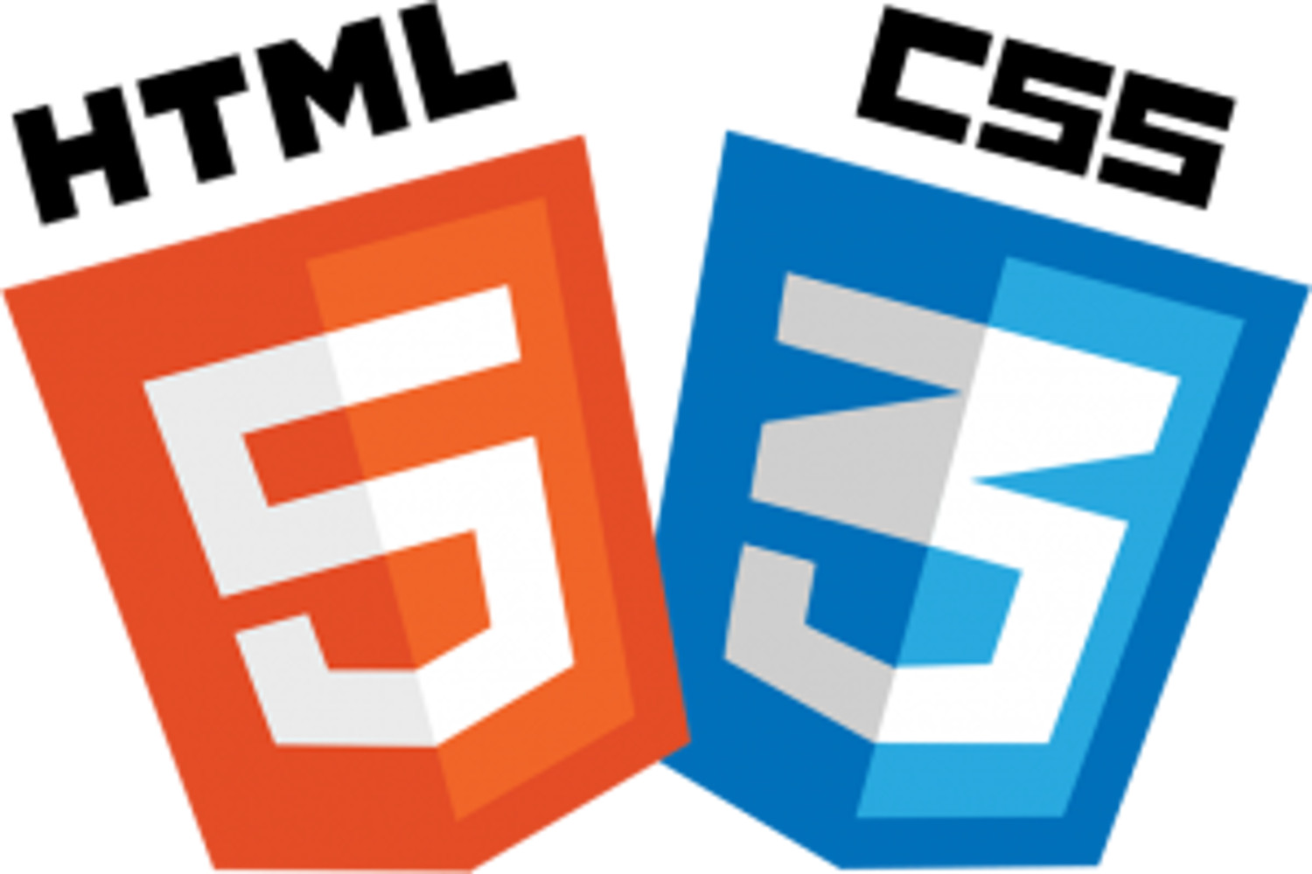


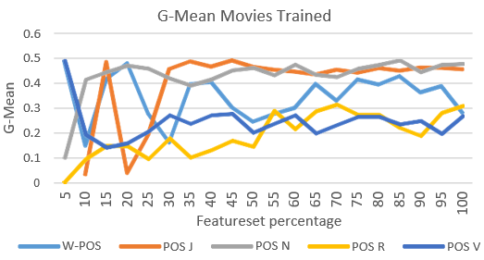
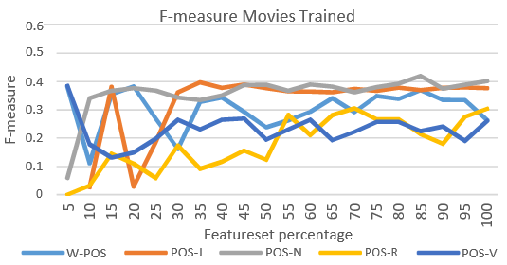
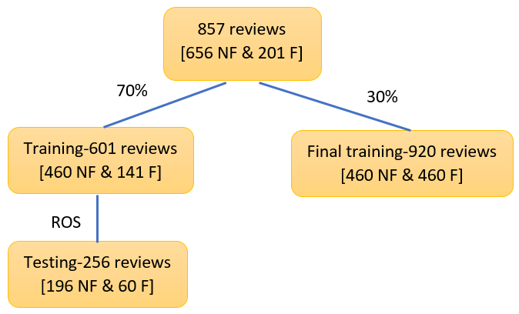
Project Name
First Year Project Poster, Fall 2019, Bennett University, Greater Noida, India
Member Name 1 (Enrollment 1), Member Name 2 (Enrollment 2), Member Name 3 (Enrollment 3)
Dept. of Computer Science Engineering, Bennett University, India
Introduction
Techniques Utilized
The aim of this project is to evaluate our proposed mining approach to automate the validation of requirement reviews generated during an inspection of NL requirements document
Problem
The faults that are reported during requirements inspection contains some false-positives i.e. reviews that are not fault but are reported as faults.
You may use images to explain or mix of text and images.
Couple of lines on what each technique will do.
User Interface/Demo Snapshots
Solution
Our proposed mining approach used supervised learning classifiers, reviews (requirements and movies) and features generated during study run to evaluate the accuracy and G-mean (Geometric mean of precision and recall).
You may use images to explain or mix of text and images.
Fig. 2. Details of Experiment Steps
TABLE 1. SAMPLE TABLE
1. Bayesian | 2. Support Vector | 4. Regression
Naïve Bayes | Linear SVC | Logistic Reg.
Multinomial NB | 3. Ensemble | SGD
Bernoulli NB | Random Forest trees | 5. Trees
 | Extra Tree | Decision Trees
Fig. 3. Results of inspection trained model for G-mean and F-measure
Conclusion
The accuracy shows the evaluation of classification model in predicting true-faults and non-faults while G-mean in this paper, shows the evaluation of classifier over minority class only (Table 4). The best feature set threshold for movies trained is 45% while for inspection trained is 65%. The difference in threshold values is significant because 45% of movies feature set is many times more than 65% of inspection train.
Future Work
Training over movie reviews produced better results and the model trained on movie reviews present most precise G-mean and F-measure score when they are trained on at least 45% of the total features generated.
Fig. 1. Sample figure

